Slide 1
EPLUS INC
Phase 3
Aly Dabo, Justin Oliver, and Jordyn Reid

Slide 2

ABOUT EPLUS
IT financing company that sells IT assets.
Founded in 1990.
Split between technology and financing.
Technology side delivers hardware, software, and consultation.
Finance side of Eplus inc includes financing operations comprise sales.
Over 1,700 employees across 23 USA locations.

Slide 3
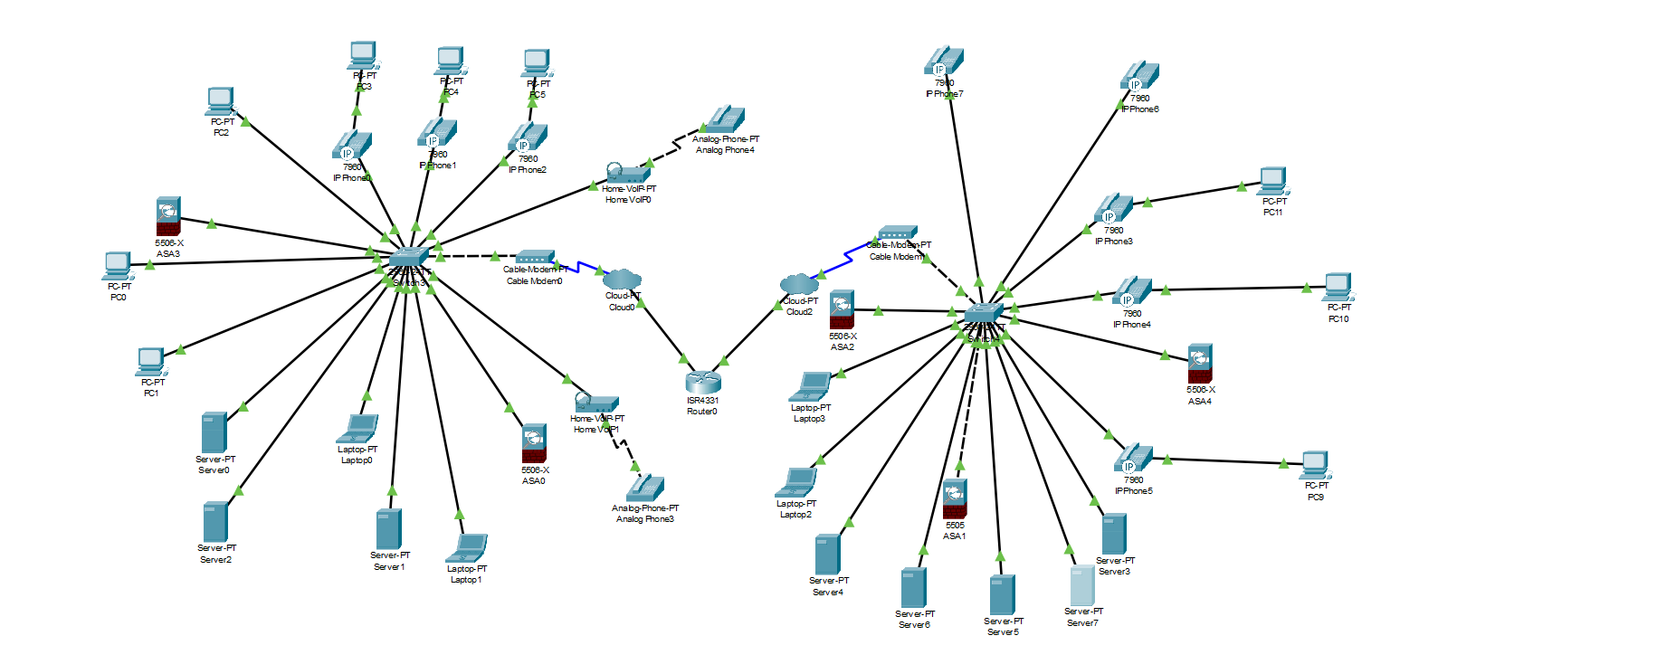
EXAMPLE OF A OFFICE OF EPLUS

Slide 4
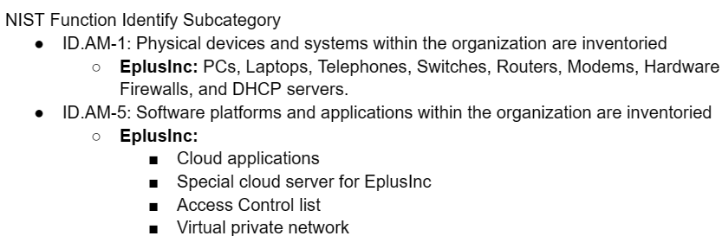

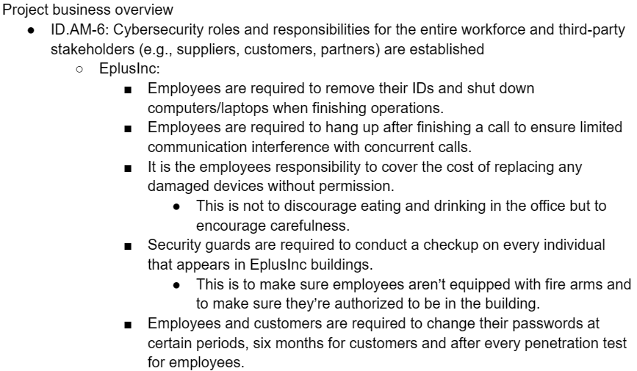
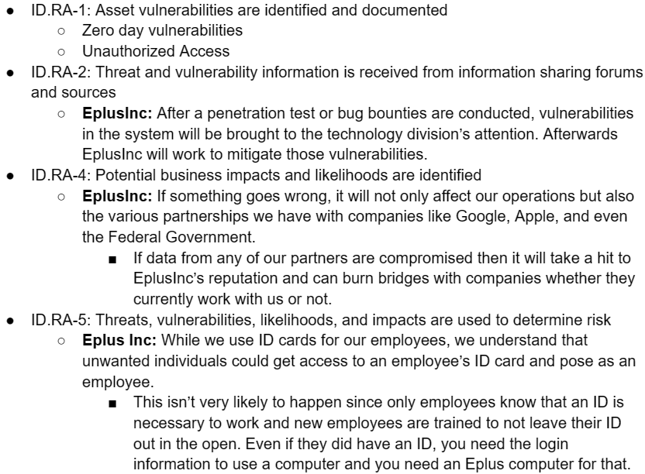
NIST and Subcategories: Identify

Slide 5
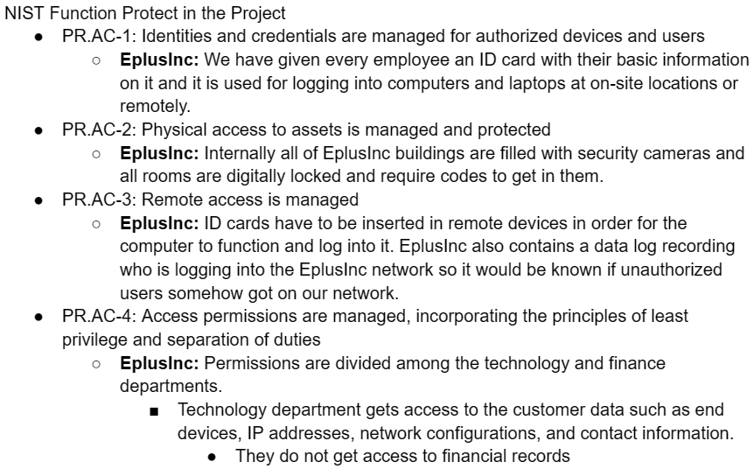

NIST and Subcategories: Protect

Slide 6
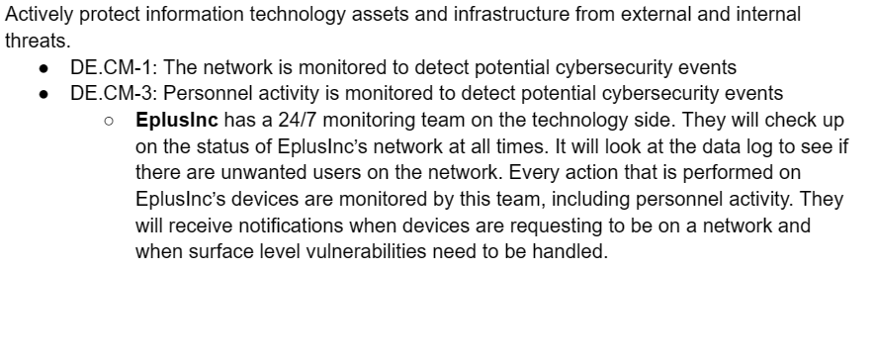

NIST and Subcategories: Detect

Slide 7

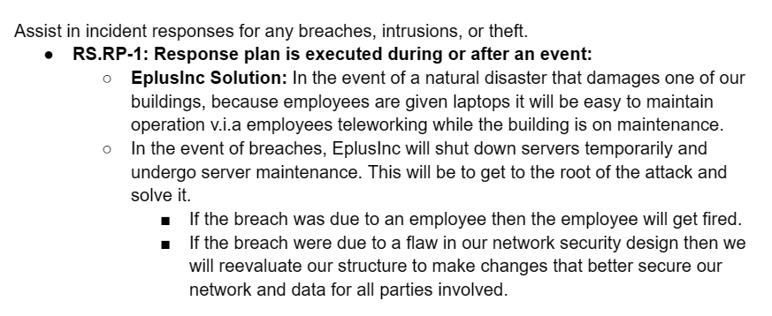
NIST and Subcategories: Response

Slide 8
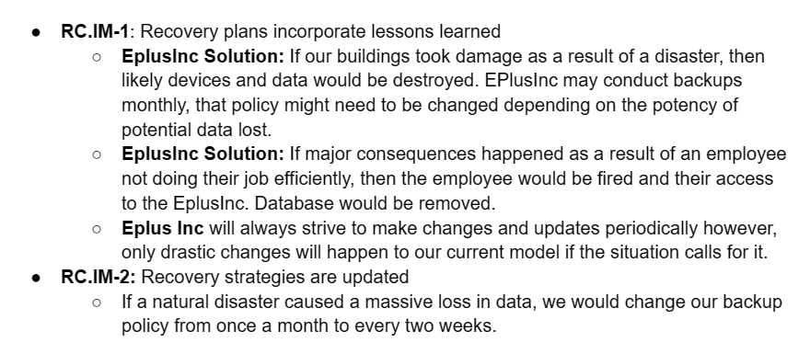
NIST and Subcategories: Recovery

